Slide 1
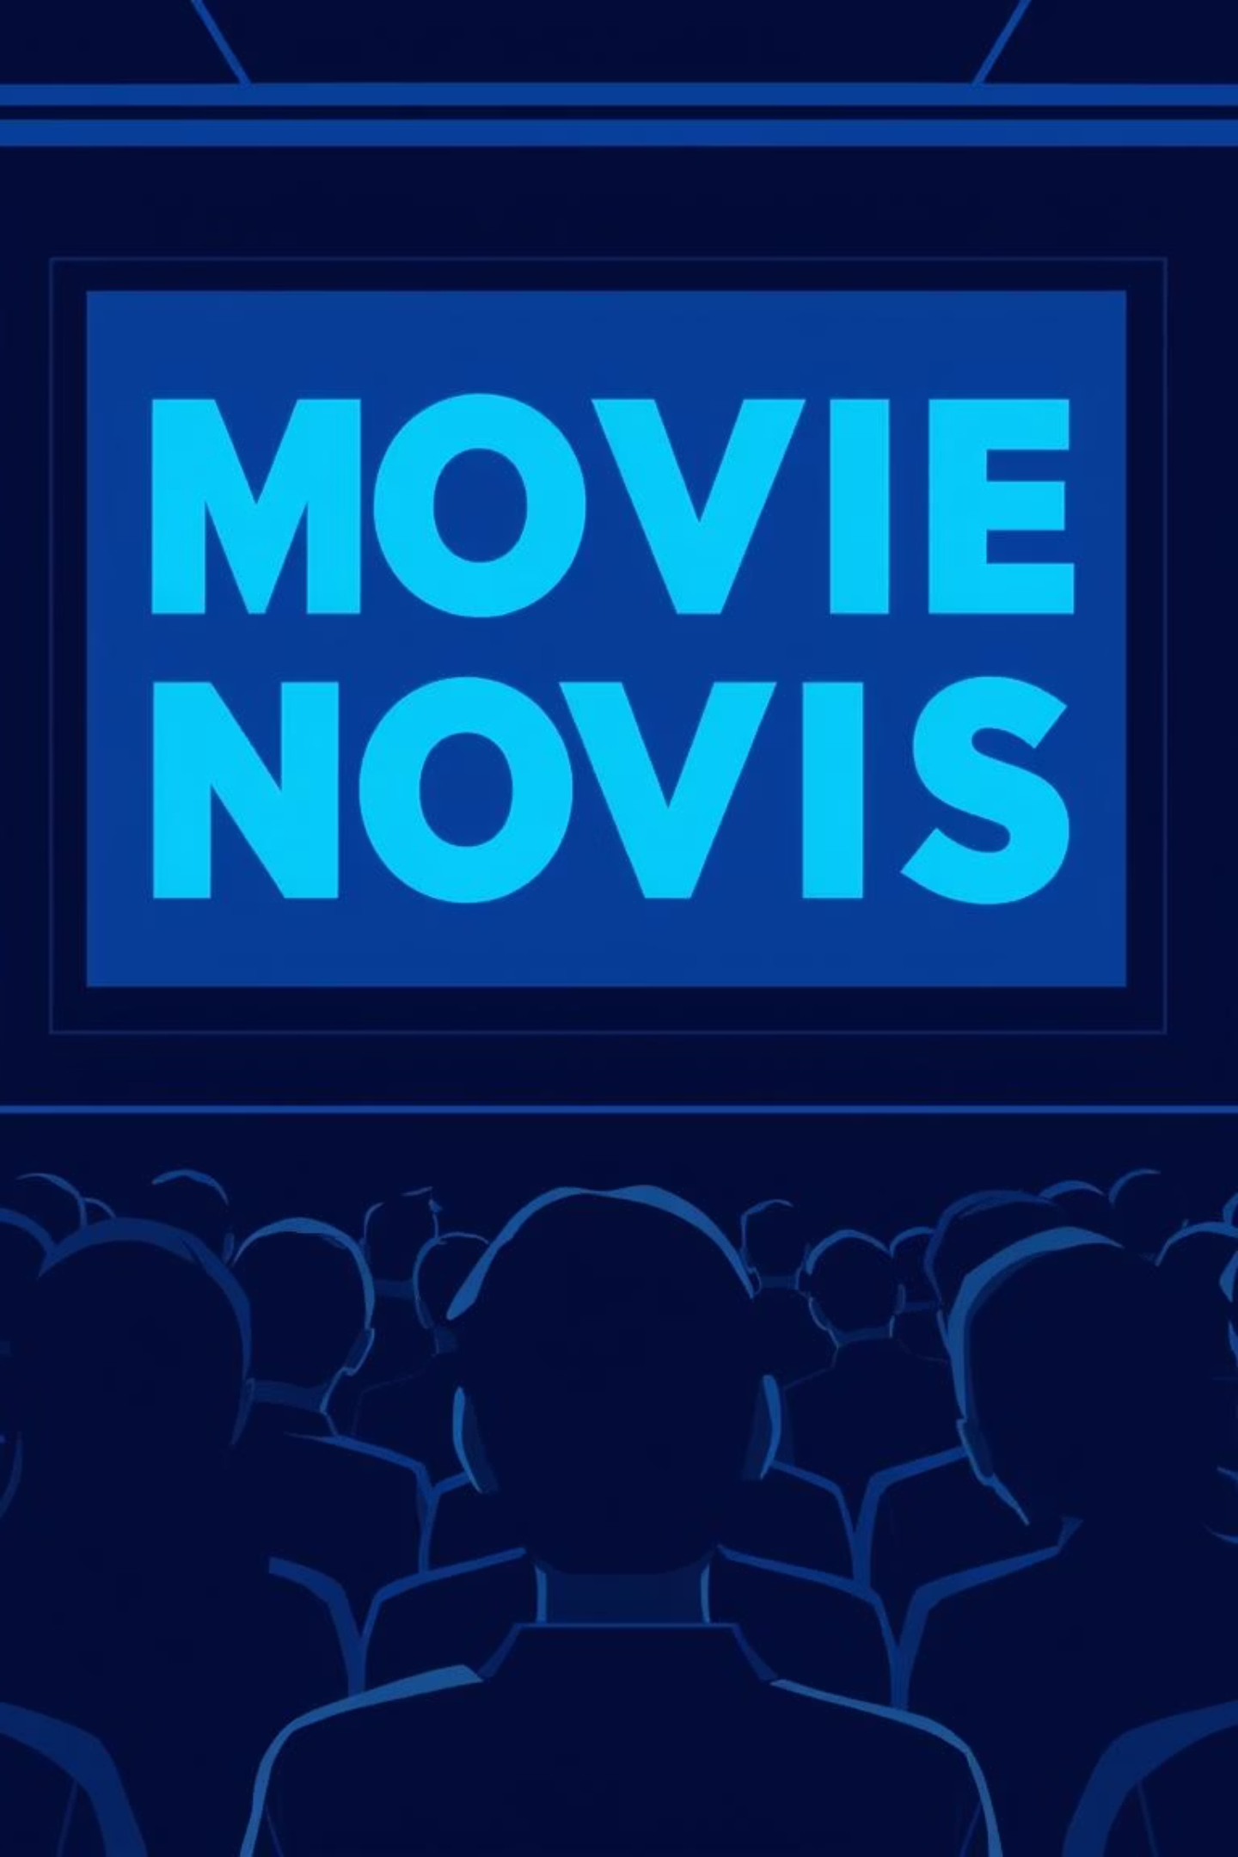
Movie Recommendation System
Leveraging ALS in PySpark for Personalized Entertainment
Dataset: MovieLens (100k ratings) | Tools: PySpark MLlib | Technique: Collaborative Filtering

Slide 2

THE CHALLENGE
Navigating Infinite Choices
Users face decision paralysis with overwhelming content libraries. The need for personalized suggestions is critical for engagement.
Ratings.csv: userId, movieId, rating, timestamp
Movies.csv: movieId, title, genres

Slide 3
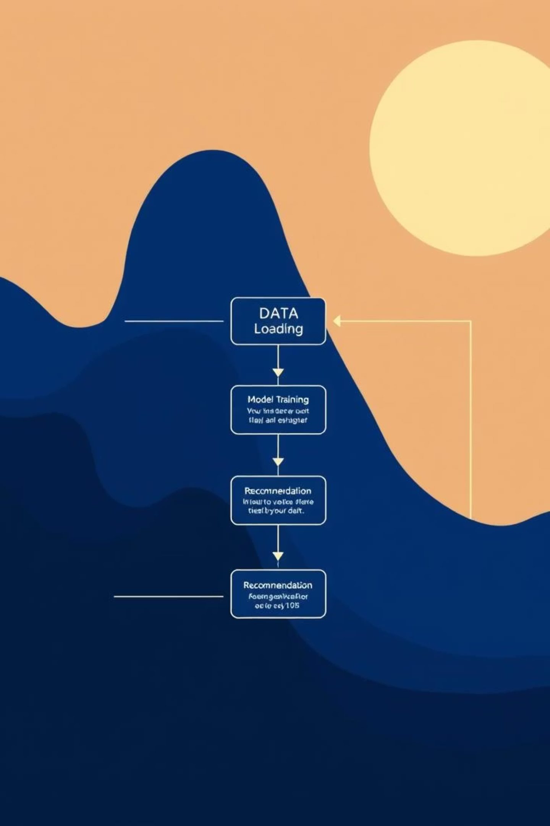




OUR APPROACH
ALS Model Workflow
Load Datasets
Ratings & Movies data
Train ALS Model
Collaborative Filtering
Evaluate
Measure RMSE accuracy
Generate Recommendations
Top-N Movies

Slide 4
IMPLEMENTATION
PySpark ALS in Action
Utilizing PySpark MLlib's ALS for scalable recommendation engine. Parameters tuned for optimal performance:
1
Toy Story (1995)
Animation|Children|Comedy
4.2
Rank: 10
RegParam: 0.1
1
Jumanji (1995)
Adventure|Children|Fantasy
3.8
MaxIter: 10
ColdStartStrategy: 'drop'
Movie titles and genres joined for rich recommendations.
2
Forrest Gump (1994)
Comedy|Drama|Romance
4.5
2
Pulp Fiction (1994)
Comedy|Crime|Drama
4.1

Slide 5
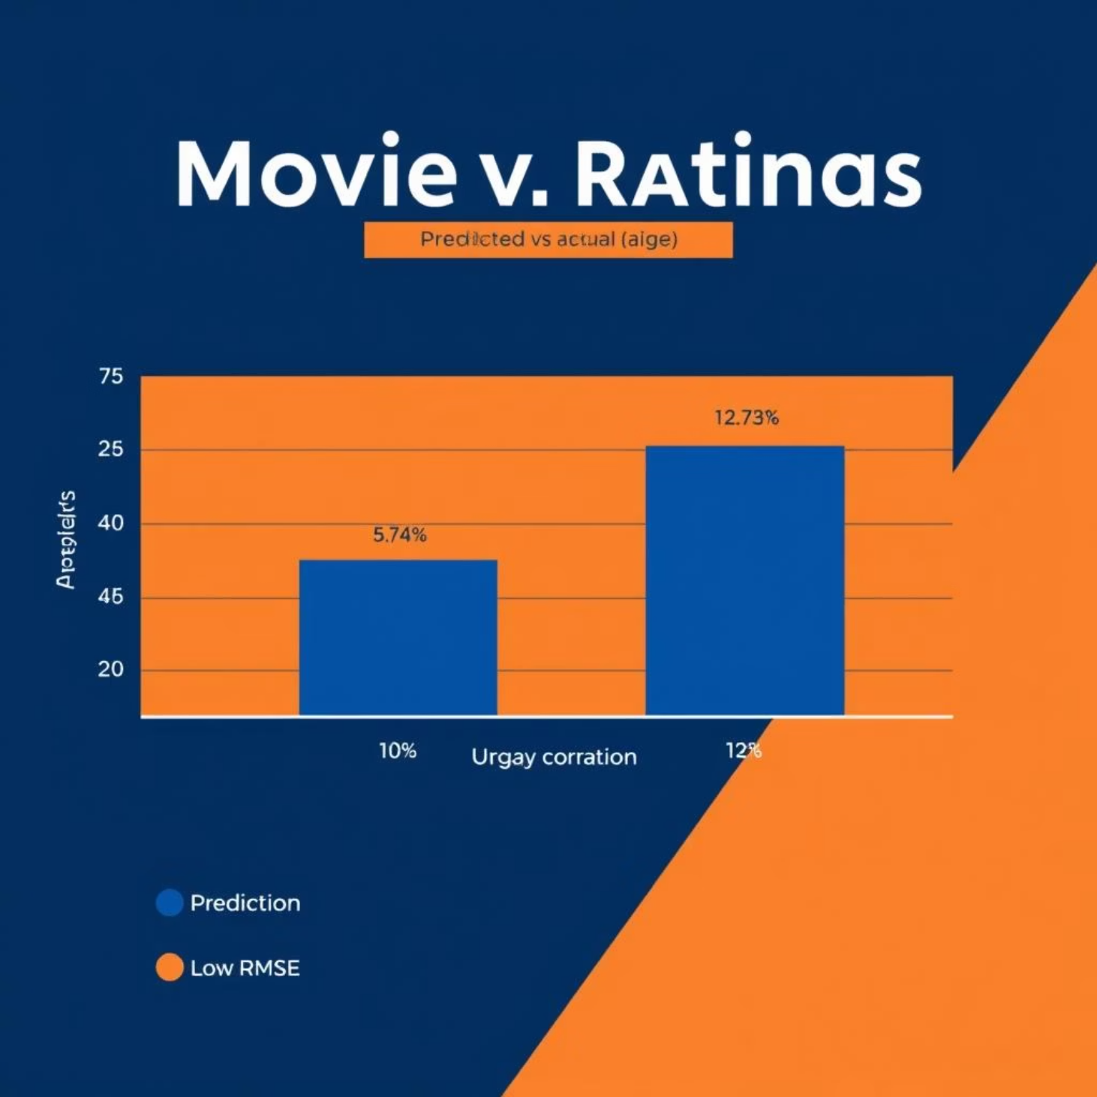
OUTCOMES
Impact & Future Potential
Key Results
Achieved a robust RMSE of ~0.85, indicating high prediction accuracy.
System generates personalized Top-10 movie recommendations for each user.
Significance
Enhances user experience on streaming platforms.
Drives content discovery and increased engagement.
Reduces churn by providing relevant suggestions.

Slide 6
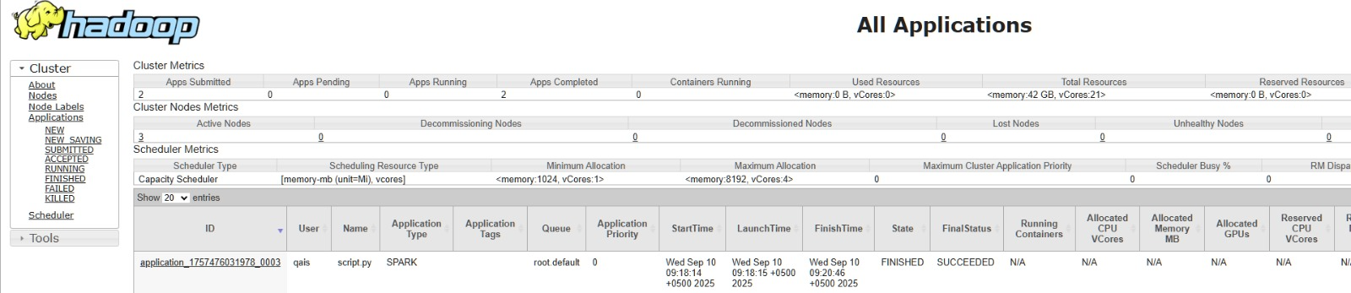
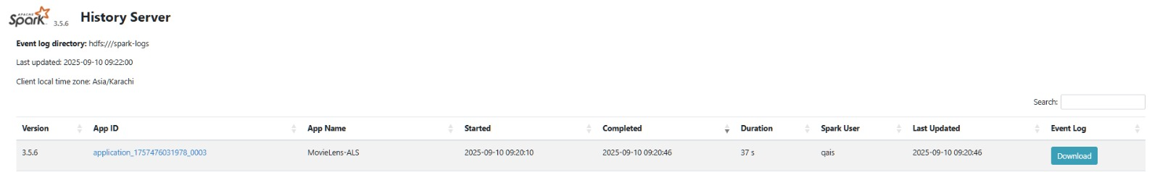
YARN
SPARK

Slide 7
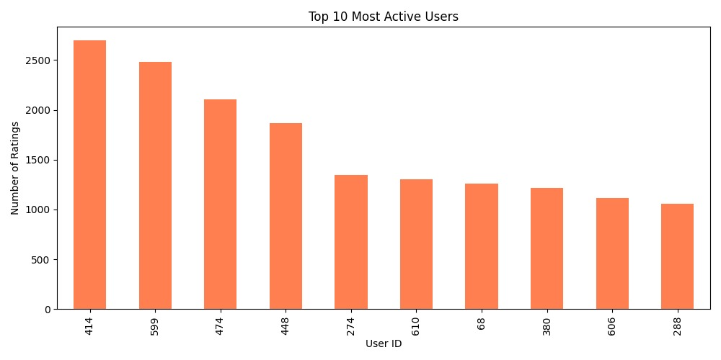
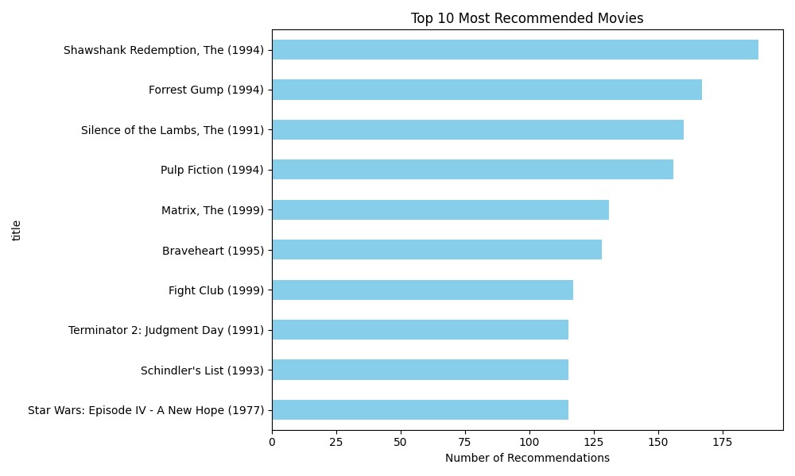
Graphs
Top 10 Active Users
Top 10 Recommended Movies

